Slide 1
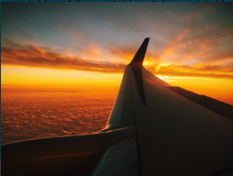
Flight Price prediction

Slide 2
Problem Statement:
Flight ticket prices can be something hard to guess, today we might see a price, check out the price of the same flight tomorrow, and it will be a different story.
To solve this problem, I have extracted data with help of selenium prices of flight tickets for various airlines the months of October 2021 New Delhi to Bengaluru c, using which we aim to build a model which predicts the prices of the flights using various input features

Slide 3
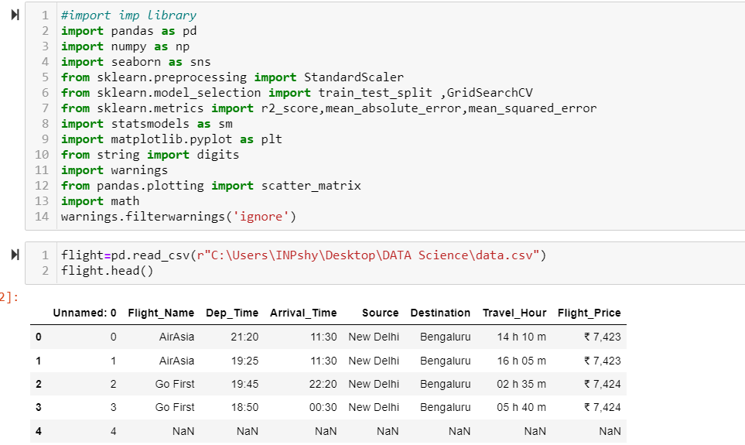
EDA(Exploratory data analysis )
First step to import library and the import data file

Slide 4
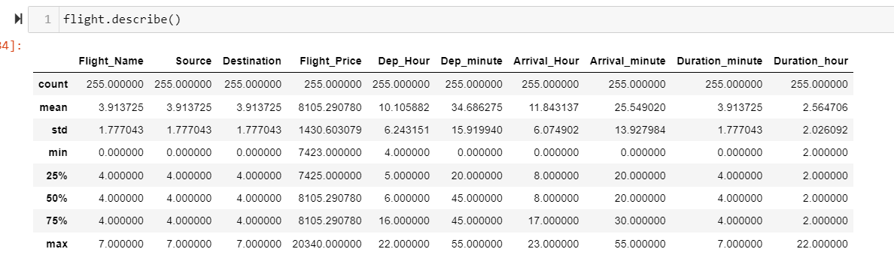
Data Types and Shape , and column name cleaning
Final Data shape is 255 rows and 10 column, describe method give how data distributed

Slide 5
Data cleaning
print(data.info()) give data information that how many object ,integer, float type data present in dataset.
Then I identified most of the data object which need to convert in numerical values i.e Flight_name ,Source,Destination,Dep_hour,Arrival_Hour,Arrival_minute, ,Duration_minute,Duration_hour.
data.nunique() provide how many unique values present in dataset.
data.isnull().sum() to check any null values present in dataset.

Slide 6
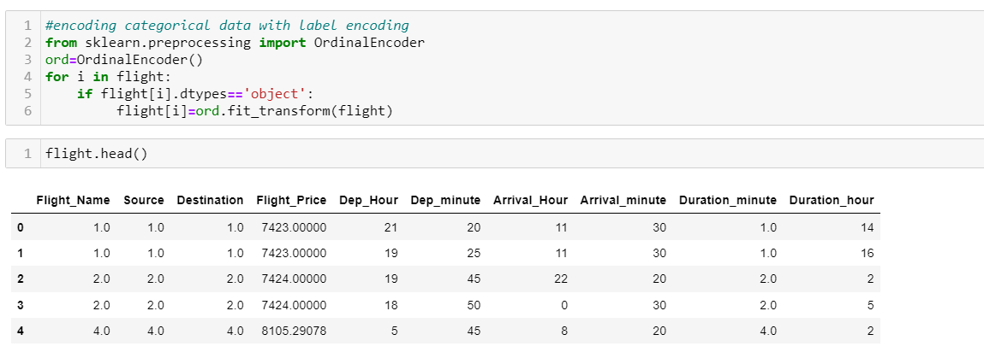
Encoding Categorical data
Moving forward I have to convert object data into numeric data to build ML

Slide 7
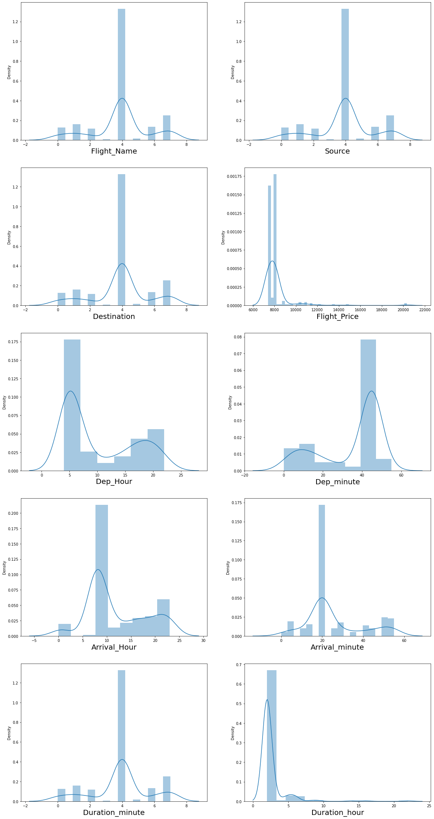
Distribution plot to get overview how data distributed

Slide 8
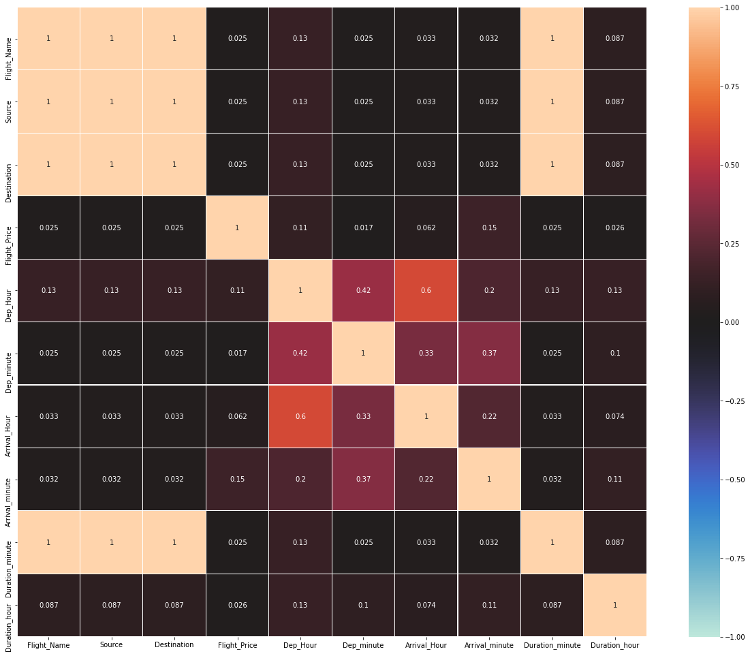
Heatmap to understand correlation between features

Slide 9
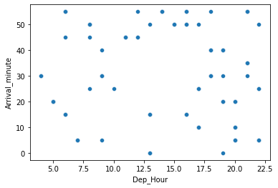
Scatter plot to check correlation
Moving forward plotting heatmap to check multicollinearity we can cross check with scatter plot where it have high score.

Slide 10
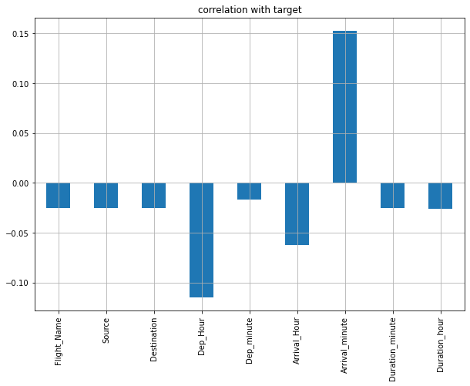
Correlation with target variable (label)

Slide 11
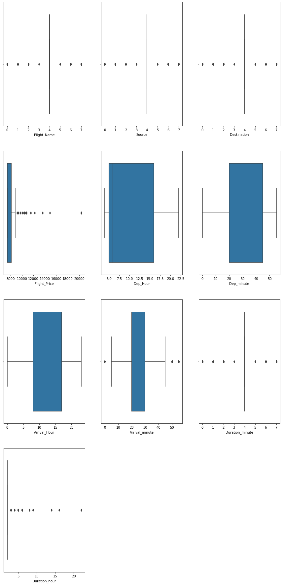
Boxplot to check outliers
.

Slide 12
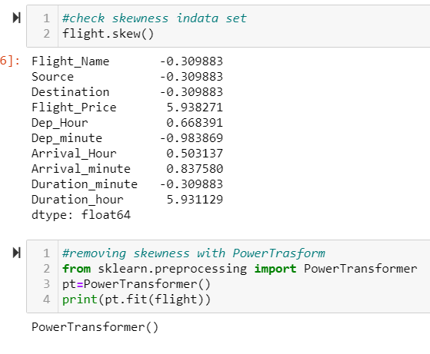
Power Transformer and Label count
Power transformer use to remove skewness in data

Slide 13
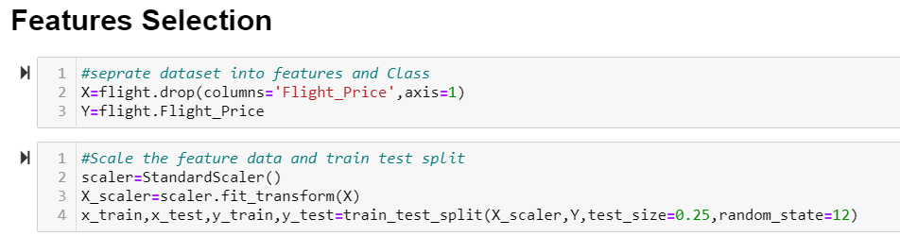
Scale ,Train Test Split the features data
Scaling features data and train test split

Slide 14
ANALYSIS OF RESULTS
I have taken very limited data due to time constraint ,only Delhi to Bengaluru with particular date only.so result and accuracy is too low. I have to work more here in future to add more route and different dates.

Slide 15
Future Work
I will add more route and different date and months to get more accurate insight of flight price prediction.
Optimization and will use different algorithm

